Slide 1

IEEE Xtreme 2013

Slide 2

What is IEEE?
Worldwide:
The world’s largest professional association for the advancement of technology.
“IEEE core purpose is to foster technological innovation and excellence for the benefit of humanity.”
NC State Student Organization:
Promote professional and technical development through various activities and services.

Slide 3
IEEE Xtreme Competition
24 Hr Programming competition
~6,000 teams around the world
Fun event with free food provided
Competition held in Progress Energy Conferences in EBII
Companies present – great opportunity to network (bring resumes)

Slide 4
IEEE Xtreme Benefits
Great team work/team building exercise
Challenge and learn new software skills
Wonderful networking opportunity
Meet new people with similar interests

Slide 5
Grand Prizes
The winning team members claim ultimate bragging rights and are recognized as some of the world's top up-and-coming programmers.
Grand Prize includes an expense-paid trip to the IEEE conference of your choice anywhere in the world.
2nd & 3rd place overall: Netbooks for each team member
All prizes are sponsored by the IEEE Computer Society.

Slide 6
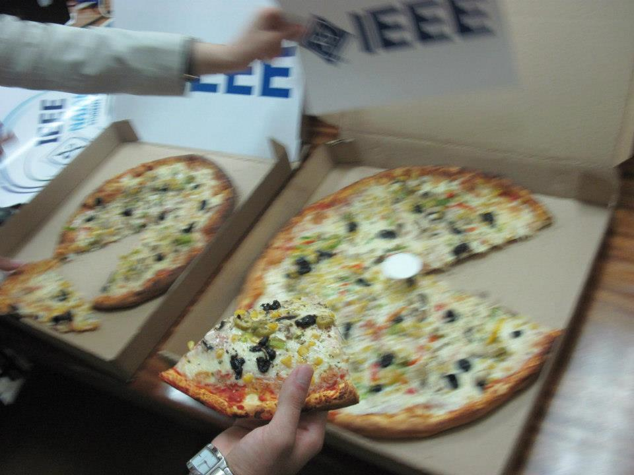
What does IEEE do for you?
Aid in registration process
Group contestants in teams (if needed)
Support teams
Answer questions
Serve food and drinks

Slide 7
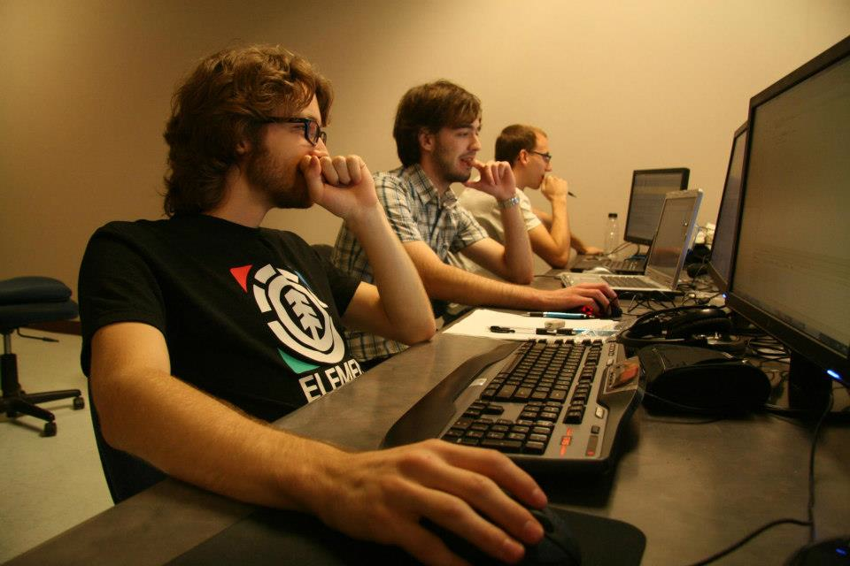
IEEE Xtreme Requirements
Personal criteria:
Membership ID (Need to be IEEE student members)
$16/6mo. or $32/yr. to become a member (30% off on Oct. 1st)
Proctor ID (Provided by us)
Team criteria:
Max 3 people per team
Only 2 grad students per team

Slide 8
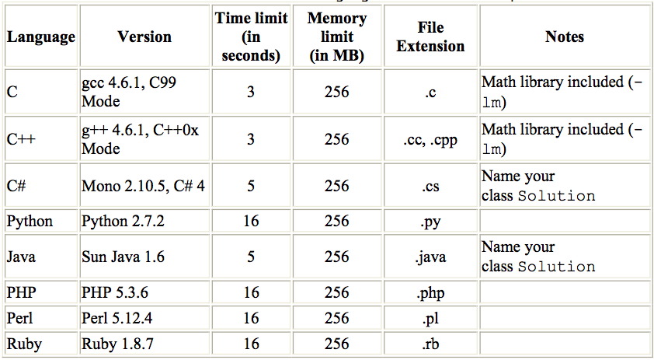
Programming Languages

Slide 9
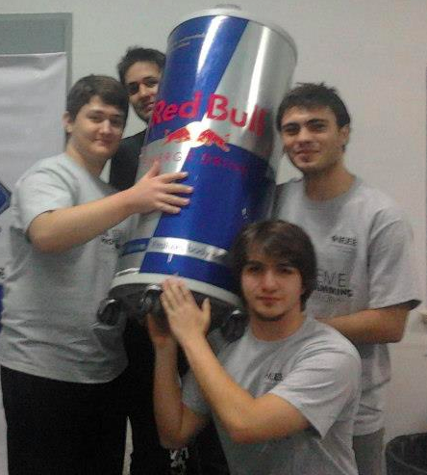
IEEE Registration
Sign-up for event with NCSU IEEE organization
Sign-up available here
Register online at IEEExtreme
Deadline is October 10th

Slide 10
Don’t have a team?
If you don’t have team, this is the right time to talk to people and search for a team.
Post on Facebook page and we will help you find a team.
Feel free to contact us!

Slide 11
How to contact us ?
IEEE NCSU website :http://students.engr.ncsu.edu/ieee/
Email: ncsu.ieee@gmail.com
Facebook page : https://www.facebook.com/IeeeXtremeNCSU?ref=hl

Slide 12
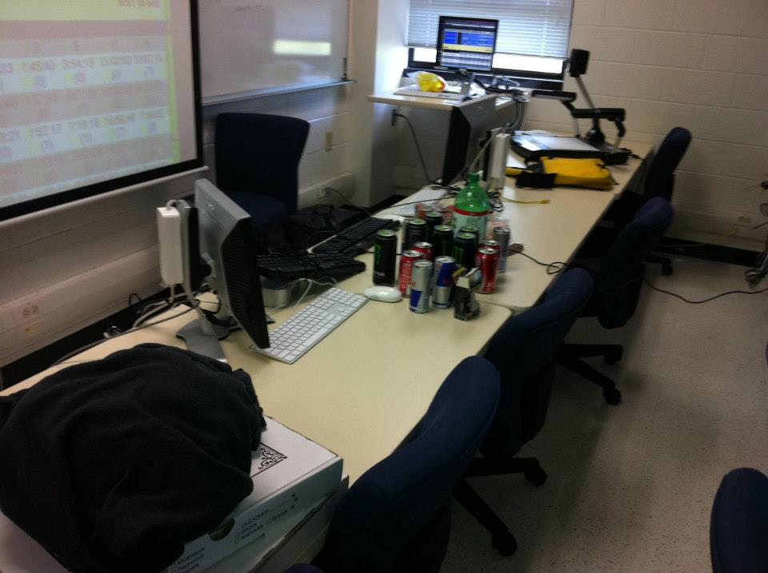
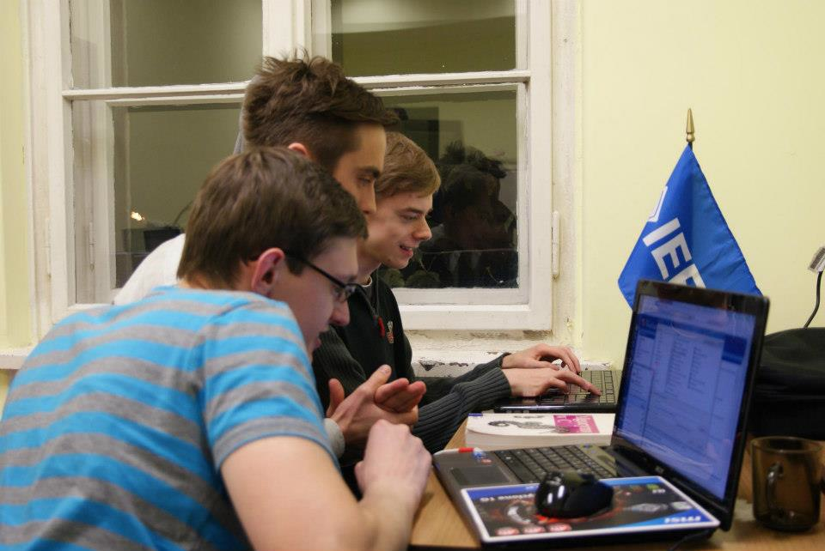
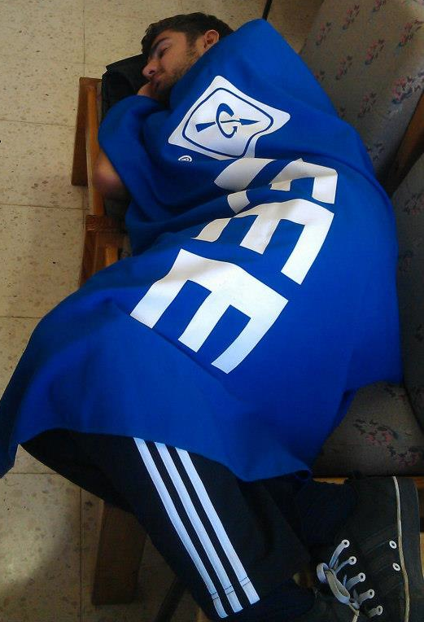
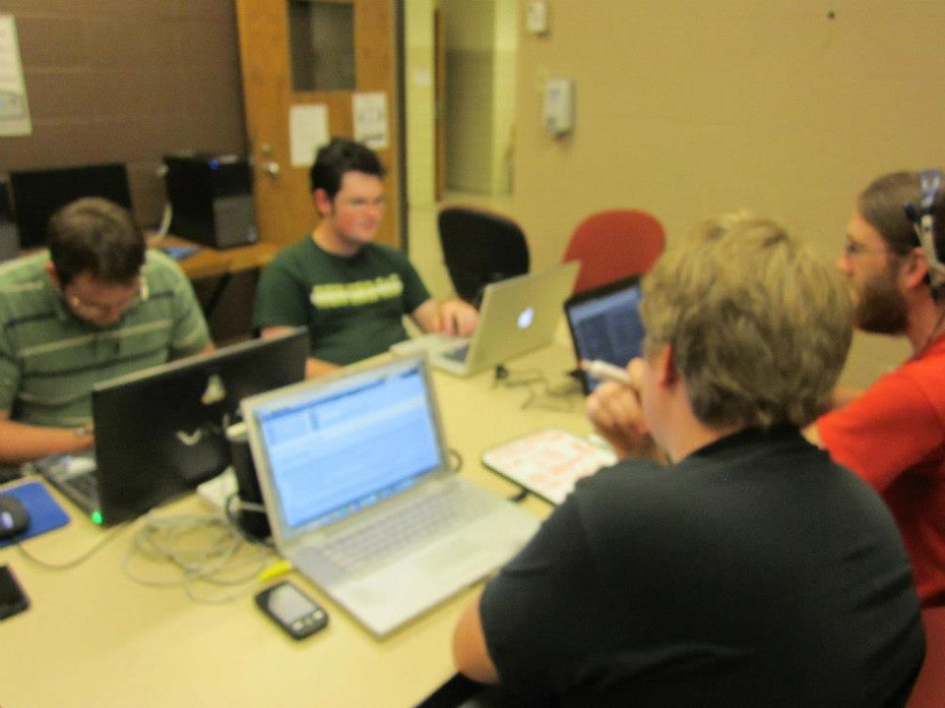
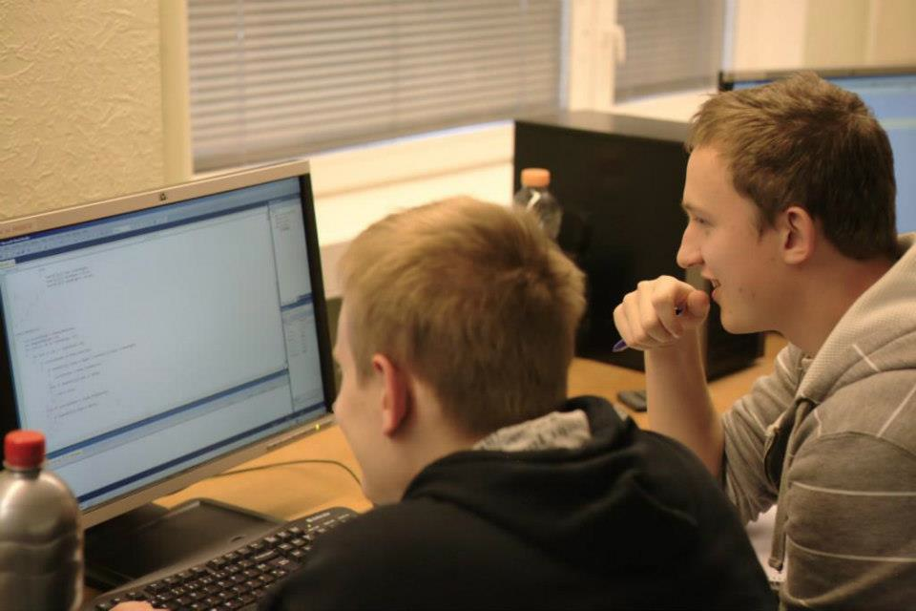
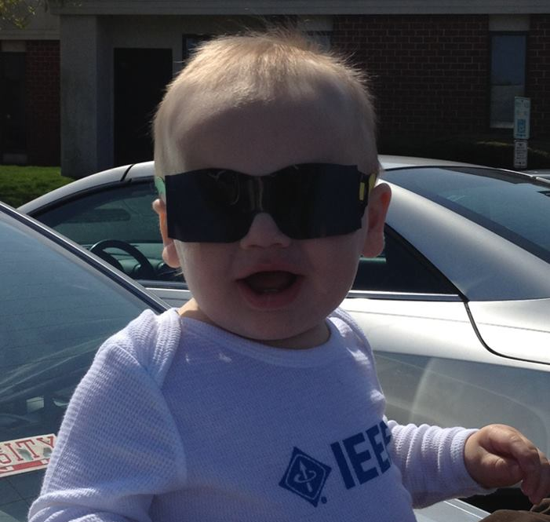
IEEE Xtreme Pictures

